Slide 1

Business Performance Review (2020–2023)
Sales Dashboard

Slide 2
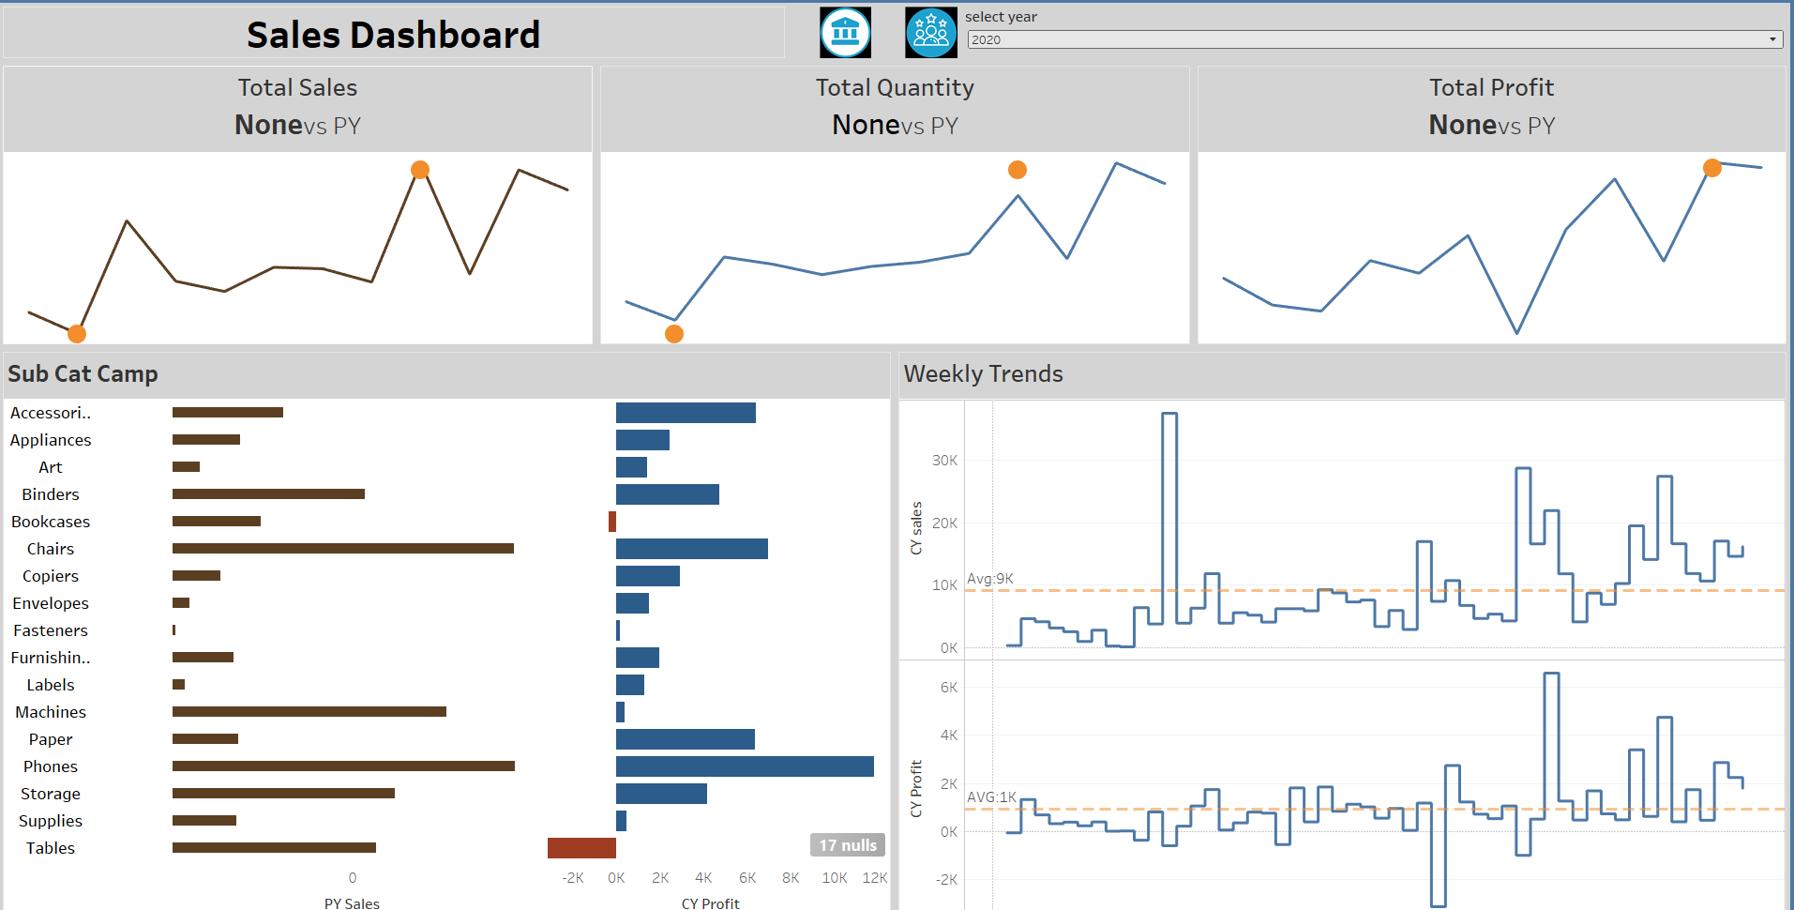
2020 – Overcoming Challenges
Context: Summarize the business landscape in 2020 (e.g., pandemic impact, market shifts).
Key Takeaway: Highlight resilience, adaptation, or foundational achievements shown in the image.
Metrics : Reference trends ("Stabilized revenue despite market volatility") Profit 1000 and Sales 9000 as Avg.
"In 2020, our focus was on navigating unprecedented challenges. This visual shows how we maintained operational stability and laid groundwork for recovery."

Slide 3
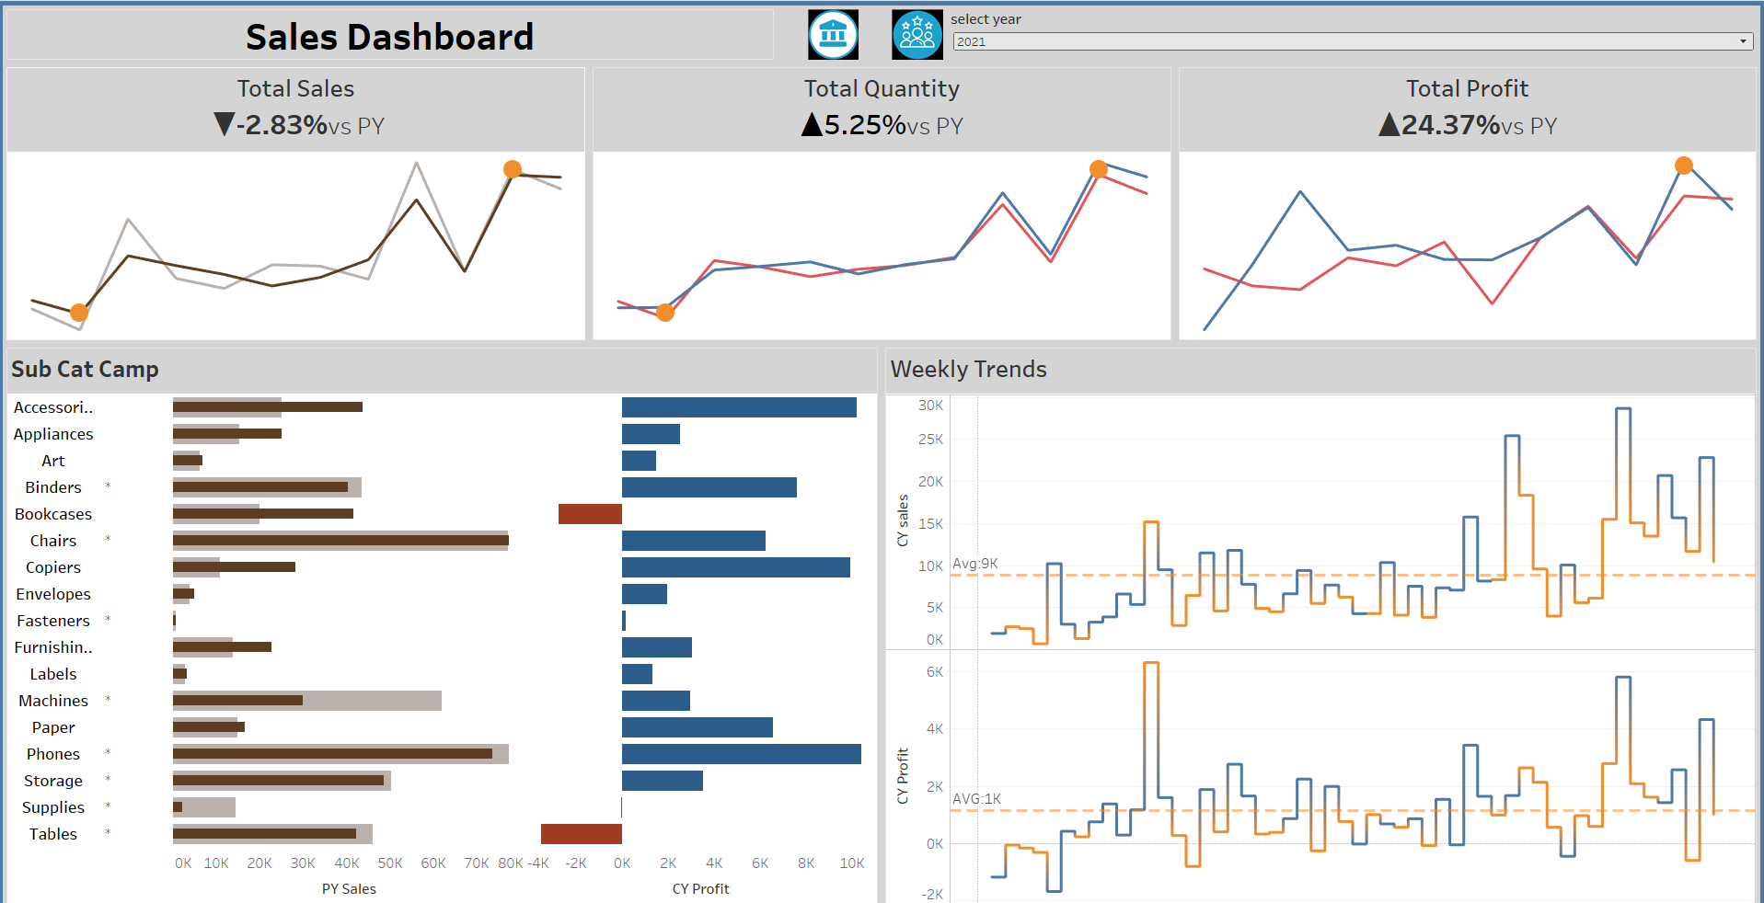
2021 – Growth and Recovery
Context: Economic recovery or strategic initiatives launched.
Key Takeaway: Growth areas (new markets, product lines).
Metrics: Highlight improvements ( “24.37% increase in customer acquisition").
"2021 marked a turnaround. This chart reflects successful strategies, driving measurable growth."

Slide 4
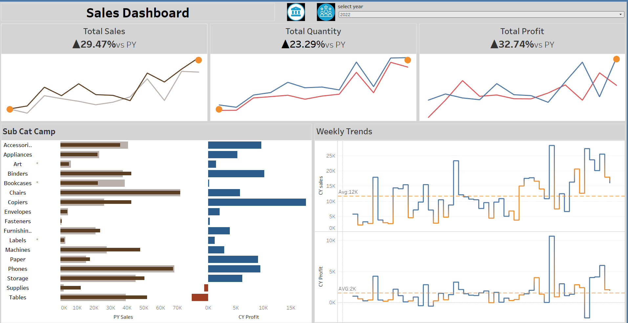
2022 – Scaling Success
Context: Expansion or optimization efforts.
Key Takeaway: Scalability or efficiency gains.
Metrics: Compare to 2021 ( "Profit margins improved by 8.37%").
"By 2022, we scaled operations efficiently. This image demonstrates how we leveraged to sustain momentum."

Slide 5
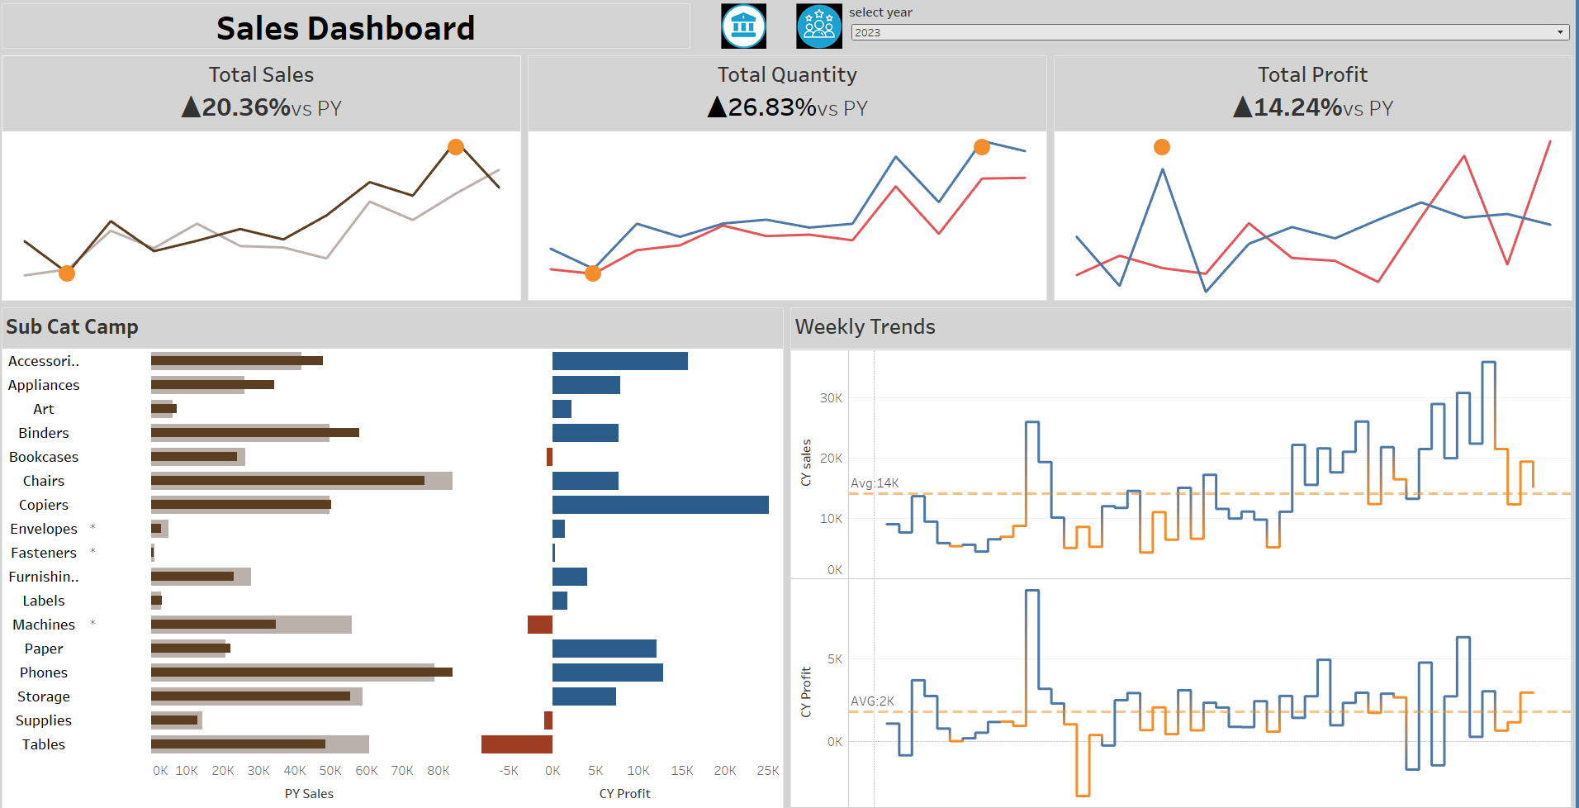
2023 – Innovation and Future Readiness
Context: Emerging trends or technologies adopted.
Key Takeaway: Competitive positioning or future goals.
Metrics: Year-end projections or milestones.
"In 2023, we prioritized innovation. This visual underscores our readiness for upcoming opportunities."

Slide 6
Thank You

